Slide 1
Implementation and Delivery plan of AI-2025
COMPANY
- Prajwal Kumar Hemmakki Rathnakar
Notes:
Introducing the Teammates and group number
One line about – Bayesian Prior

Slide 2
Agenda
Recalling first discussion…!
How can a PM lead the different roles in IT?
How will a PM measure the success of a bigger goal?
What is PMs new Fee Structure on base of Bonus?
Can a PM handle the project with 500K$ fee?
MS Project
Close out on Information gaps, Personalities and conflicts, and roles and organization structure

Slide 3
Let's Recall…!!!
Established True Goal of AI-2025
Project Management Tool – Agile
Industry Expert Opinions considered
Key Stakeholders’ Goals & Motivations
Contract Type – Time and Materials
Measured Key Performance Indicators
Conducted Project Pre-Mortem
Designed the Project Charter

Slide 4


Slide 5
PM’s lead on different roles in IT
Action: Facilitate and support the business analysts in gathering, documenting, and validating project requirements
Requirement
Gathering &
Analysis
Action: Keep the team informed about ongoing maintenance activities, priorities, and any changes that may impact their work.
Maintenance
&
Support
Application
Architecture
& Design
ROLES IN IT
Action: Collaborate closely with the design team to understand the user experience goals, and ensure they have necessary design tools
Action: Ensure that all aspects of the deployment, including software, hardware, and configurations, are thoroughly planned and documented.
Implementation
&
Deployment
Development
&
Coding
Action: Identify and allocate resources based on team members' skills and project requirements.
Testing &
Quality
Assurance
Action: Collaborate with the testing team to develop risk mitigation strategies and contingency plans to address potential issues.

Slide 6






PM’s Success Measure
True Goal of AI-2025: Increased stock valuation.
Effective Leadership and Communication
Action: Confirm that the AI system aligns with
Company's broader goals and strategic objectives.
Positive Impact on Forecasts & Sales Revenue
Action: Collaborate with Business Unit Leaders
and analyze the impact of AI implementation on
sales revenue.
Mitigation of Risks and Challenges
Action: Implement strategies to mitigate
resource-related risks and prevent project delays.
Manage resource and their mental well-being
Action: Assign tasks to team members based
on their skills, expertise, and workload capacity.
Personnel Cost Savings
Action: Monitor and quantify the actual personnel cost savings achieved through the implementation of the AI system.
Adherence to Budget and Timeline
Action: Ensure that the project is completed within
the allocated budget and that any deviations are
justifiable and necessary.

Slide 7
Documenting Information gaps
Missing buy-in from BU Leaders
Action:
Schedule meetings with each Business Unit Leader to discuss the model, understand their expectations, and address any concerns they may have.
Action:
Coordinate with Helen and TPZ to clarify the timeline for the media announcement and ensure it aligns with the Company's overall strategy.
Absence of Fixed Time Schedule
Closure on Font-end and Back-end tools
Action:
Work closely with HR and Finance to view the risks associated with personnel layoffs. Develop mitigation strategies, such as communication plans and potential incentives, to minimize the impact on existing teams.
Handling Personnel Layoffs
Action:
Consider factors such as functionality, ease of use,
scalability, cost, and compatibility with existing systems.
Addressing these information gaps through clear documentation and communication will contribute to a more informed and successful AI implementation project

Slide 8
New Fee Structure Based on Incentive
Assuming Q1 is reserved for Analysis and Planning phase and Implementation phase (Development, Testing and Deployment) phase happening in Q2 and Q3, with GO-LIVE in Q4; below is the Direct Cost for my Team:
500K$
Approximating Team Resource cost : 370000$
Go-Live Incentive promised to meet KPIs: Bonus: 50000$
Variable costs which might arise due to future change requests: 20000$
Opportunity costs when chosen alternative path: 10000$
By linking bonuses to key success factors, we contribute to on-point goals of the company
such as personnel cost savings and positive market perception.

Slide 9


Is $500,000 is enough fee?
If things go as planned:
Considering the budget allocation and the incorporation of Key Performance Indicator (KPI) incentives, the $500,000 budget appears sufficient.
Collaborative decision-making and open communication channels between project managers, finance teams, and relevant stakeholders contribute to a more effective budget management strategy.
Incase of any deviations:
Considering the Project Charter draft, a comprehensive evaluation of potential risks and uncertainties should be undertaken. This aims to identify if additional funds might be required to guarantee the successful completion of the project without compromising quality or objectives.
In cases where a Change request pops-in or the project scope or requirements experience significant expansion, it may be justified to request additional funds to adapt to these changes effectively.
Keeping an eye on the possibility of fluctuations in the economic or market conditions is crucial, as these external factors may impact the overall project budget.

Slide 10


Slide 11
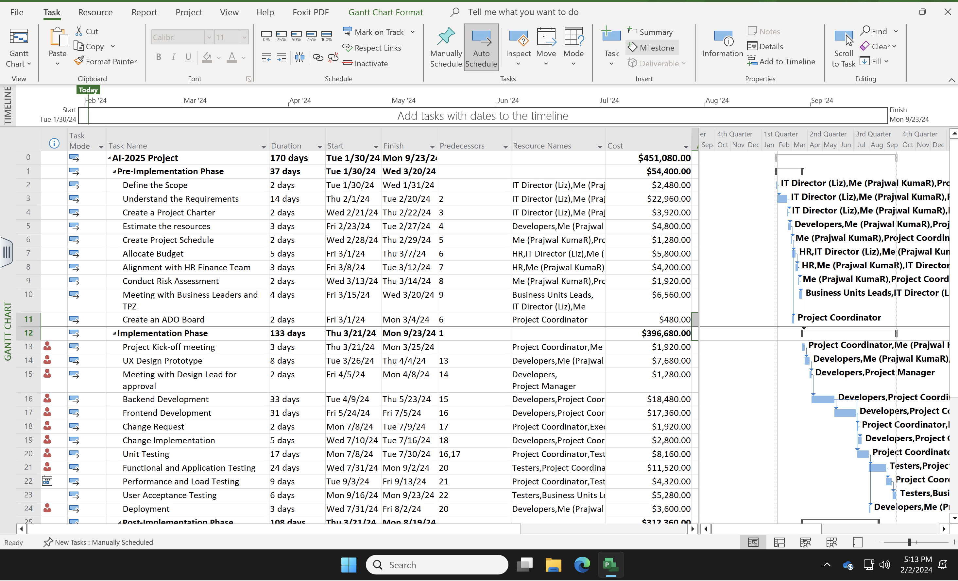

Slide 12
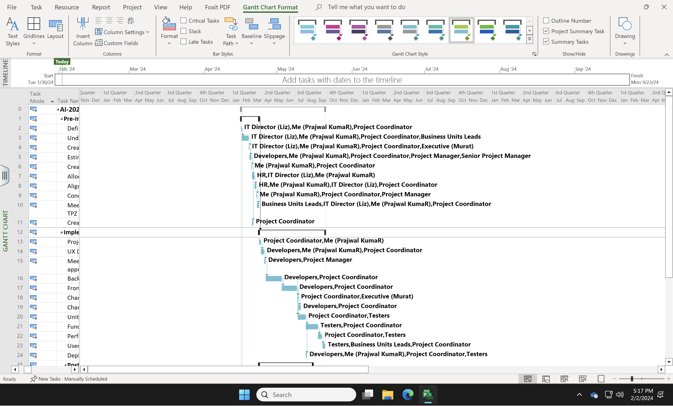

Slide 13
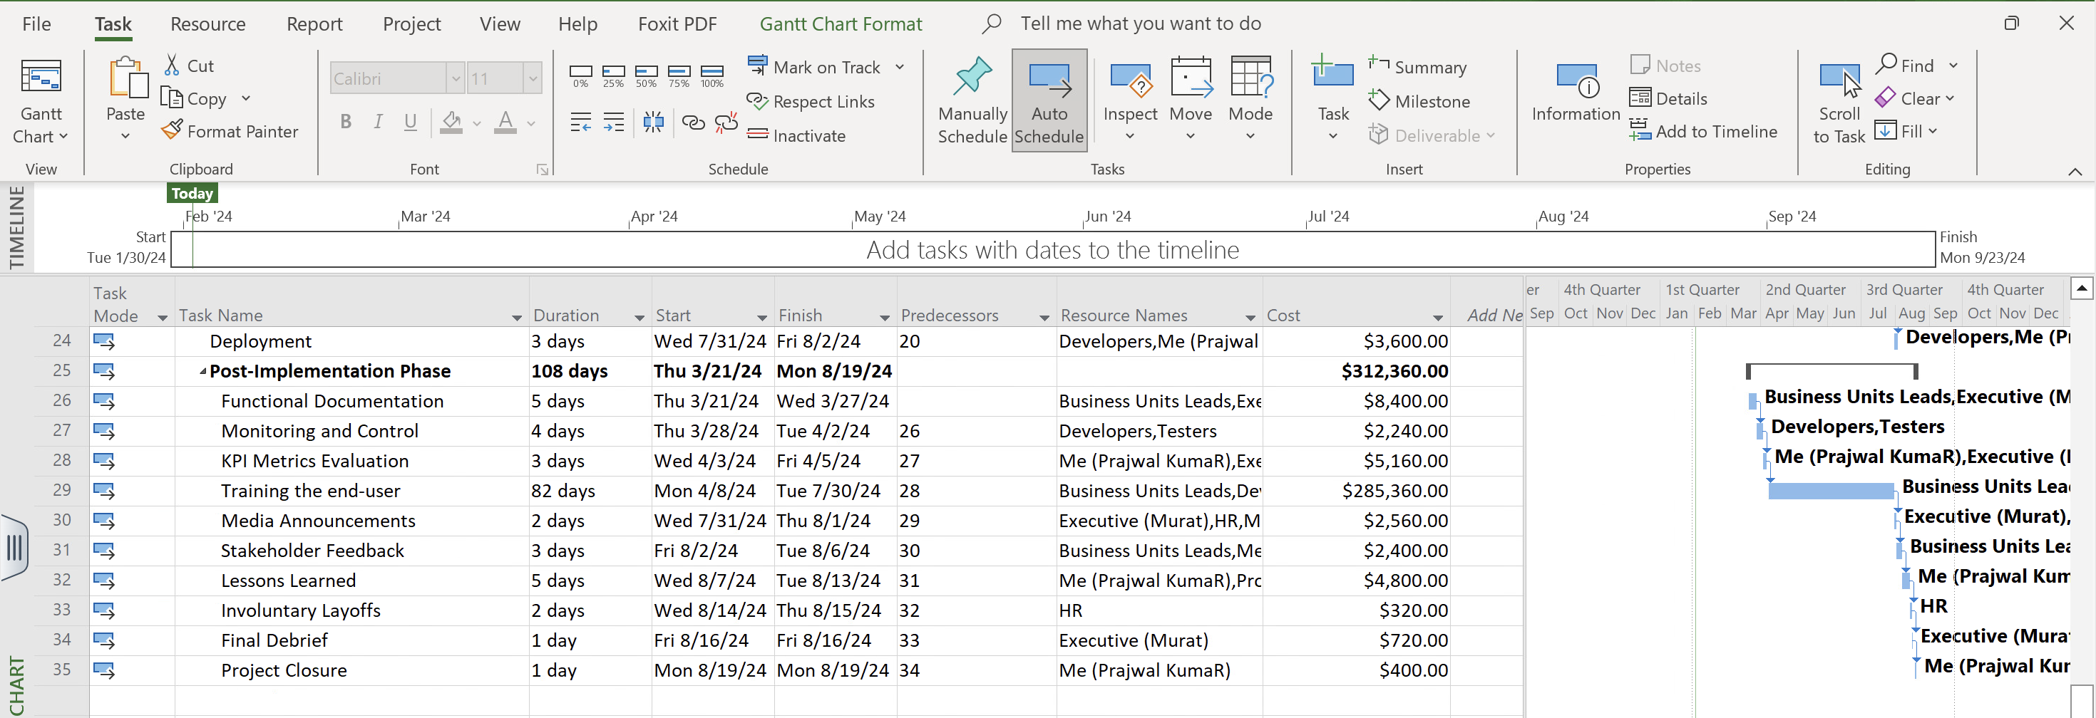

Slide 14
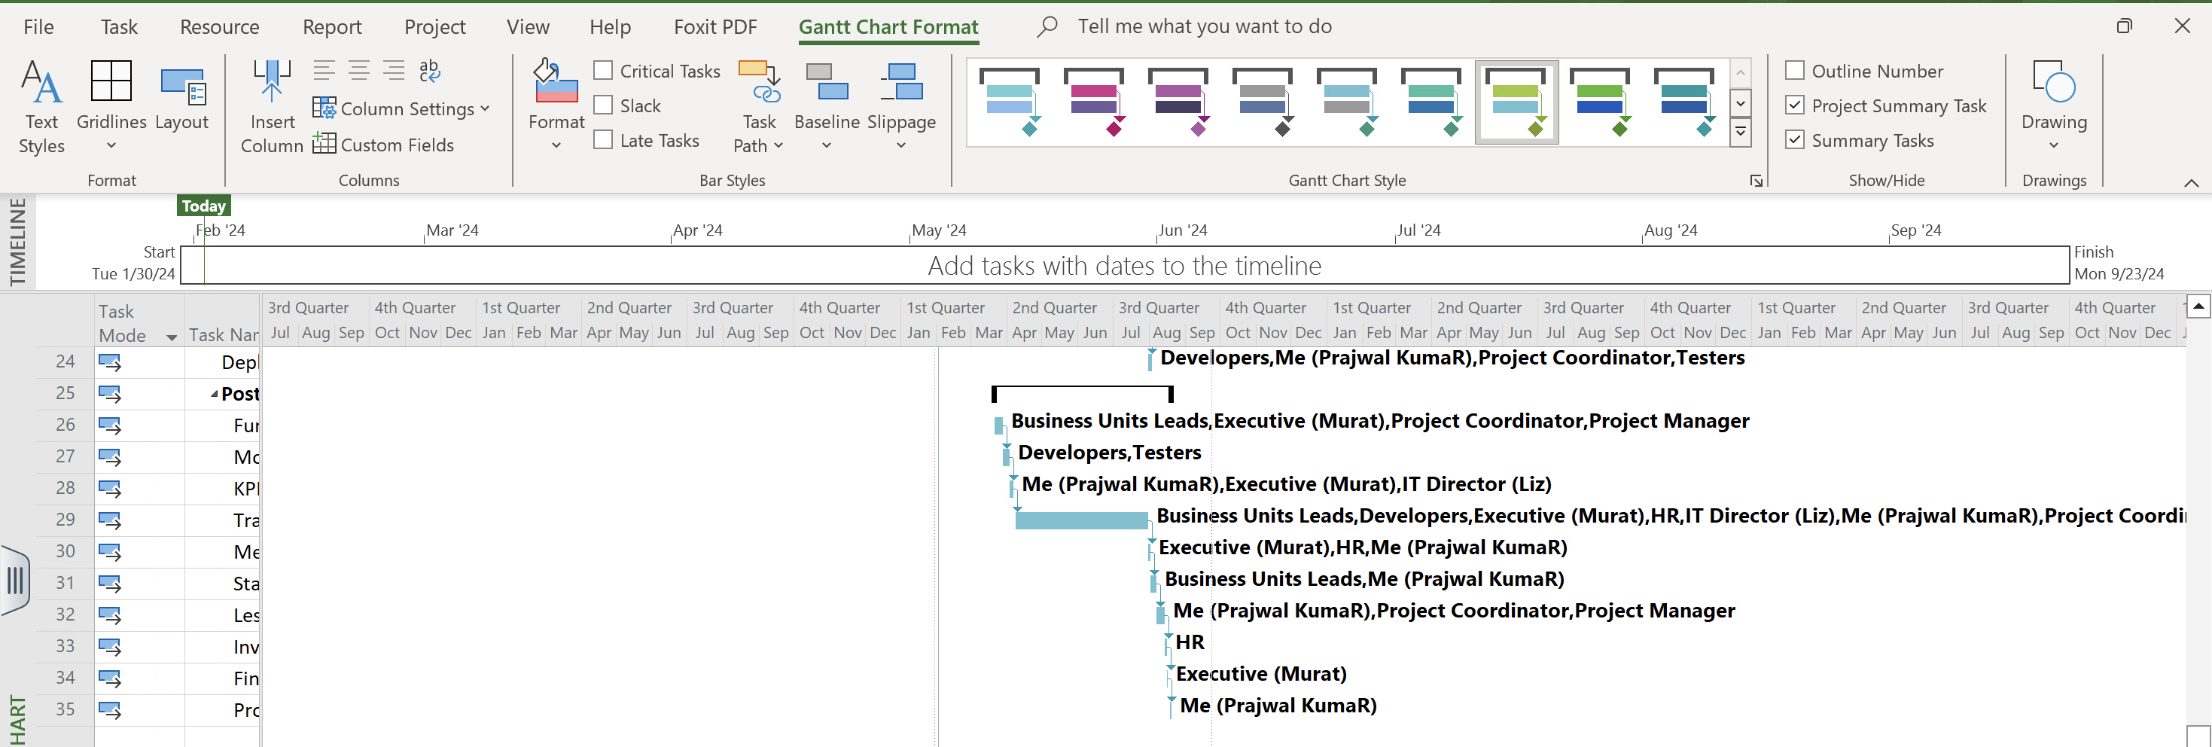

Slide 15

CLOSEOUT

Slide 16



Closeout on Information Gaps
Issue: Communication gap be two Business Unit Team
Solution: Conduct individual meetings with Business Unit Leaders to make sure that they understand each others tool and address any concerns among them. Document their level of buy-in and create a comprehensive strategy to secure their ongoing support.
Issue: Absence of a clearly defined framework
Solution: Collaborate with stakeholders, especially Helen and Murat, to define a structured framework for decision-making. Document the processes and roles responsible for key decisions and approvals.
Issue: Poor homework on Personnel Layoff
Solution: Work closely with Human Resources and Finance to assess risks and develop mitigation strategies, such as communication plans and potential incentives. Document the risk assessment and mitigation plan to ensure a smooth transition.

Slide 17


Closeout on Personalities & Conflicts
Issue: Clear-out Historical Conflicts
Solution: Facilitate structured discussions between Liz and Helen to address historical conflicts. From Liz's perspective, it appears that Helen has not fully handed over responsibilities, and this lack of clarity is causing frustration. Create an environment where team members can express concerns and work towards resolution. Establish ground rules for respectful communication.
Issue: Clash due to Involuntary Layoffs
Solution: The realization that colleagues, friends, or team members have lost their jobs can evoke feelings of insecurity and diminish the overall morale within the workplace. The resulting atmosphere of unease can hinder productivity, collaboration, and innovation. The repercussions of such workforce reductions often create a ripple effect, causing a collective sense of uncertainty, anxiety, and demotivation

Slide 18


Closeout on Roles and
Organization Structure
Issue: Undefined Roles and Responsibilities
Solution: Gather everyone in the team for a meeting to make sure everyone knows exactly what they're supposed to do. Talk about each person's job, what they're responsible for, and who they report to. Clearly define the boundaries of each role and encourage collaboration through regular communication channels
Issue: Lack of Flexibility in Organizational Structure
Solution: Provide that leverage to the co-workers where they can bring forth any creative suggestions or any disagreement they have. Take a look at the way the organization is set up and make it more flexible to better handle the changing needs of the project. Let team members have more say in making decisions about their areas of work. Make decisions faster and more flexibly to avoid delays.

Slide 19
THANK YOU
COMPANY

